Slide 1
When Fast-Growing Economies Slowdown: International Evidence and Implications for China
Author: Barry Eichengreen
Donghyun Park
Kwanho Shin
Presenter: Yixin Xu

Slide 2
Background
Rapid economic growth of large emerging markets: China and other countries in developing world
Late-developing countries grow more rapidly than early developers: reap productivity gains simply by shifting workers from underemployment in agriculture to export-oriented manufacturing and utilize the imported technologies from advanced economies.

Slide 3
Rapid Growth Come to An End
Nelly Furtado: rapid growth cannot last forever
Underemployment in rural labor diminishes
Share of employment in manufacturing peaks
Growth comes to depend more heavily on the difficult process of raising productivity in the service sector
Must transition from relying on imported technology to indigenous innovation

Slide 4
Literature Review
Ben-David and Papell (1998): 74 advanced and developing countries, 1950-90, break-points for GDP growth rates.
Industrialized countries - 1970s; developing countries – 1980s
Not utilize criteria related to the magnitude of their growth slowdowns
Did not examine the income levels at which slowdowns occur or their determinants
Pritchett (2000): growth stagnates or collapses, typical cross-country growth regression
Did not identify determinants of shifts from sustained growth to stagnation or collapse.
Reddy and Miniou (2006): real income stagnation
Rodrik (1999), Ros (2005), and Hausmann, Rodriguez, and Wagner (2008) : determinates of growth collapses

Slide 5
Questions:
When fast growing economies slow down?
What are the characteristics and circumstances on which the timing of the slowdown depends?
When China?

Slide 6
Identifying Slowdowns
Directly follows Hausmann, Pritchett, and Rodrik (2005)
When the rate of GDP growth satisfies three conditions:
g_{t,t-n} ^{≤ 0.035,}
^{gt,t-n - gt,t+n ≤ 0.02,}
y_{t} ^{> 10,000,}
yt = per capita GDP in 2005 constant international purchasing power parity (PPP) prices, 1957-2007
gt,t+n = the average growth rate between year t and t+n
gt,t-n = the average growth rate between t-n and t
n = 7
Notes:
7-year average growth rate of per capita GDP is 3.5 percent or greater prior to the slowdown
7-year average growth rate of per capital GDP is declined by at least 2 percentage
Only account for those countries that have a per capita GDP greater than US$ 10,000 in 2005 constant international PPP prices

Slide 7
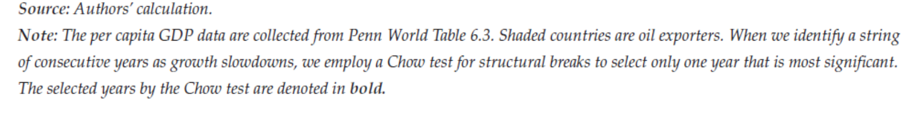
Slowdowns identified
Notes:
Greece: Chow test 1973 most significant
Select only one year out of the consecutive years identified

Slide 8
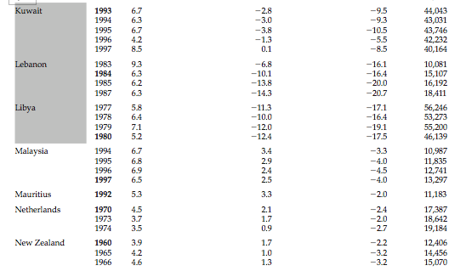

Slide 10
Method
Assign the value of 1 to the 3 years centered on the year of the growth slowdown
The dummy equals 1 for t = t - 1, t and t + 1 and zero otherwise.
The comparison group consists of the countries that did not experience a growth slowdown in that same year. The sample includes all countries for which the relevant data are available including countries that have never experienced a growth slowdown.
Drop all data pertaining to years t + 2, . . . t + 7 of the growth slowdown -- removing the transition period to which either a 0 or 1 may not be clearly assigned.

Slide 11
Additional Methods
Dummy = 1 for the entire run of consecutive years, and t-1, t+1
Include manufacturing employment share as explanatory variable vs. Do not
Oil-exporting countries included vs. removed (growth slowdowns at per capita incomes differently than other countries)

Slide 12
Results
Average for non-oil-exporting countries
High growth end at per capita GDP of US $16,740 in 2005 constant international PPP prices.
Growth rate slowed from 5.6 to 2.1 percent per annum.
China: $8,511, India: $3.826, Brazil: $9,645 in 2007

Slide 14
Slowdown Detected by the Model
European countries, first half of the 1970s, when quarter-century-long “gold age” of rapid growth and postwar recovery come to a close
Argentina, 1998, prior to its financial difficulties
Korea, 1997, financial crisis, steady but significant deceleration

Slide 15
Countries that Not on the List
China: Per capita income < $10,000 US dollar
Reduce $10,000 threshold to $7,500: 15 countries
Depressed growth relative to trend for an extended period rather than sustained slowdowns in increasing mature economies
Portugal – revolution; Romania – repay debt; Mexico – foreign-borrowing binge end; Cuban – Soviet aid curtail

Slide 16
Countries that Growth Decelerates in Steps
Japan
first slowdown in early 1970s, 6.6 percent per year between 7 preceding and subsequent years
second slowdown in the 1990s, 3.5 percent
Australia: 1961, 1974
Spain:1974, 1990
Most other counties: after an extended period of slower growth, economic reforms lead to a period of faster growth followed by a second deceleration: Argentina, Hong Kong, Ireland, Israel, Norway, Portugal, and Singapore.
Notes:
Still, in the vast majority of cases it seems appropriate to speak of a specifc point in time
and a particular level of per capita income at which a country’s previously rapid
rate of growth slowed down.

Slide 17
Outliers
Small open economies: Hong Kong and Singapore
Growth decelerations at unusually high levels of per capita GDP
Whether because they are so small or so open?
Oil exporters
High level of per capita GDP
Large amount of oil can be extracted at low cost, shift up the entire per capita income profile, other things equal

Slide 18
Proximate Sources of Slowdowns
Standard growth-accounting framework: capital input, labor input, human capital input, or technical change
Labor input as population between ages of 15 and 64
Two sets of growth accounting results:
Labor share of income by Bernanke and Gurkaynak (2001)
Set labor’s share = 0.65 for each country.

Slide 19
Results
The contribution of the growth of the capital stock fell from 2.40 percent to 1.79 percent
Labor growth from 0.89 to 0.86 percent
Human capital increased from 0.44 to 0.51
Total factor productivity (TFP) growth, from 3.04 to 0.09 percent
Growth slowdowns -- Productivity growth slowdowns ***
85 percent of the slowdown in the rate of growth of output is explained by the slowdown in the rate of TFP growth.
No longer possible to boost productivity by shifting additional workers from agriculture to industry
Gains from importing foreign technology diminish

Slide 20
Table of Results

Slide 21
Summary Statistics for the full sample countries

Slide 22
For countries experiencing growth slowdowns & For China

Slide 23
Regression
Sample: only observations that report the share of employment in manufacturing
Explanatory variables:
Per capita GDP
the ratio of per capita GDP to that in the lead country
Dependency ratio
Manufacturing share of employment
All as quadratics
Crude fertility rate

Slide 25
Results
Per capita GDP and its square are highly significant
Peak probability of slowdown occurs when
per capita GDP = US$15,389
Ratio measure of per capita income: Per capita income reaches 58 percent of that in the lead country
manufacturing accounts for 23 percent of total employment
Fertility rate, significant, positive
Dependency-ratio – not significant
The growth in the 7-year pre-slowdown period increases the likelihood of a growth slowdown.
Notes:
It is plausible that the likelihood of a growth slowdown increases as well with the speed of growth in the 7-year pre-slowdown period.
The more aggressive the exceptional measure taken to boost the economy’s rate of growth, the less likely it is that its exceptional rapid growth can be maintained.

Slide 28
Characteristics of Slowdowns
Financial openness, terms of trade shocks, and political regime changes do not have a significant impact on the likelihood of growth slowdowns.
Higher old-age dependency rates increases the likelihood
Low saving rates and slow labor force participation rates
Openness: more open to trade, less likely to experience slowdowns,
Peak: exports and imports as a share of GDP = 96 percent
Hong Kong and Singapore: open not small
Economic size have no effect
Consumption share: negative effect
Minimized when consumption is 62 or 64 percent of GDP
Investment ratio: negative effect

Slide 29
Economic Policy
Slowdown comes at lower per capita incomes in countries that
Maintain undervalued exchange rates:
More vulnerable to external shocks
Rely on shifting labor from agriculture to export-oriented manufacturing
Reluctant to abandon policy when moving to the stages that require more innovation intensive (Korea)
High and variable inflation rates
Low consumption shares of GDP

Slide 31
China
Substantial fraction of world population
Key engine of growth for the world economy. Robust Chinese demand benefit both advanced and developing countries (capital goods exports from Germany and Japan and commodity exports from Africa and Latin America, recovery in East and Southeast Asia)
Risks of excessive dependence on external demand, need to rebalance growth toward domestic sources of growth.
Rapid population aging

Slide 32
When China?
Lee and Hong (2010): aggregate growth: 6.1 to 7.0 per annum in the 2011-20 decade and 5.0 to 6.2 percent in 2021-30 decade.
Slower labor force growth
Slower increase in educational attainment
Slower increase in capital stock
Slower increase in TFP growth

Slide 33
Predictions
If grows at 9.3 percent, by 2015 China’s per capita GDP reaches US$17,335, just exceeding slowdown threshold.
If 7 percent, then 2017
If US grows at 1.9, China at 9.3, 2023 reach 58 percent ratio
Undervalued exchange rate, increased old-age dependency ratio, low consumption share of GDP – raise the probability of slowdown

Slide 34
Predictions
Per capita income around US$17,000, soon to achieve in 2017
Share of employment in manufacturing of 23 percent, China is nearly there
Income per capita in China reaches 57 percent of that in countries that defines the technological frontier, China reach only somewhat later
Higher old-age dependency ratio accelerate slowdowns
Higher and more volatile inflation rates accelerate slowdowns
Slowdowns occur at lower per capita incomes in countries that maintain undervalued exchange rates and have low consumption shares of GDP
Middle-income trap

